Slide 1

Group Members:
Data Structures: Mini Project
Aditya Mohite - 1262253387
Tanishka Parab - 1262254144
Kushal Saboo - 1262253932
Anurag Chavan - 1262253957
Bank Account Simluation
-

Slide 2
Project Overview
The primary objective of this project is to develop a robust, efficient, and secure banking simulation system using the C Programming Language. Unlike simple runtime calculators, this system is designed to demonstrate data persistence, meaning user accounts and transaction history are stored permanently in a file database, simulating real-world banking software infrastructure
The system is divided into three core modules:
Module A: Authentication & Security
-Input and check CustomerID and Password
Module B: Account Management (Write Operations)
-Opening New Accounts | Accepting User Details
Module C: Transaction Engine (Read/Modify/Write)
-Features Like: Deposit and Withdraw

Slide 3
Key Features
Why C Language?
• Persistent Data Storage
• Secure Authentication
• Real-Time Transaction Processing
• Input Sanitization and Validation
We Chose C For it is Standard for systems that require high performance and reliability.
It runs very close to the hardware, which means our
program executes calculations and searches almost instantly, without the lag of heavier languages like Python or Java

Slide 4
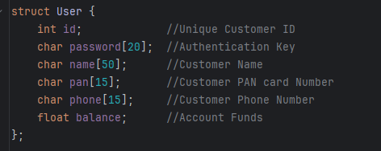
Core Data Strucuture
Important Functions and Header Files Used
scanf(“%[^ \n]s”) - Used to Handle spaces in String
[Input Sanitization]
strcmp() - Used to Match Passwords (String Matching)
<String.h> - to use the string comparison method
<stdlib.h> - to use the exit() method
We prioritized data integrity. For example, standard scanf breaks when you type a full name like 'Aditya Kumar'. We implemented specific format specifiers to handle multi-word strings. For security, we strictly use strcmp for password verification because direct operators (==) don't work on strings in C."

Slide 5
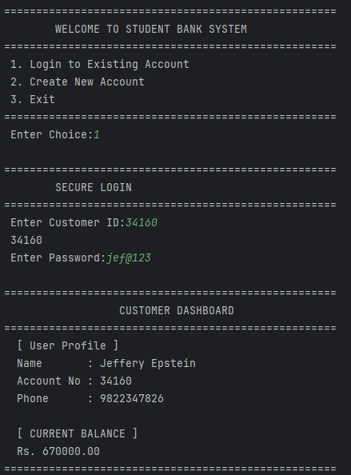
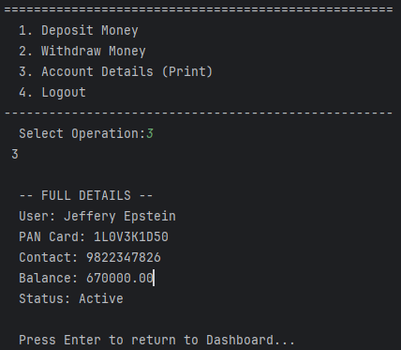
Program UI and Interface
Functions:

Slide 6
How We Store The CustomerID and Passwords
We Used DAT files Rather than conventional Text Files, which stores human-readable characters(ASCII), while a .dat file in our project stores Raw Binary Data
Why use it?
    Security (Obscurity): If you open bank_database.dat in Notepad, you will see weird symbols and garbage text. This prevents a non-technical user from easily changing their balance from 500 to 500000.
    Efficiency: It stores the data exactly as it looks in the RAM (memory). It doesn't waste time converting the number 50000 into the text characters '5', '0', '0'... it just saves the integer bytes.
    Structure: It is perfect for storing structs because it preserves the exact layout of your data variables.

Slide 7
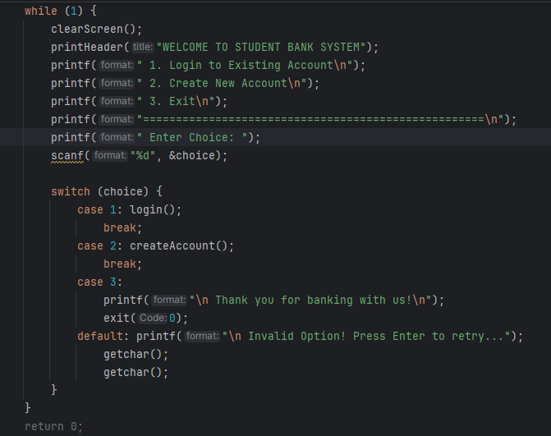
The Main Loop (Menu System)
The Backbone of our user interface is an infinite while(1) loop containing a switch case menu. This keeps the program alive until the user explicitly chooses “Exit”. it handles navigation between the Login Page, Creation Screen and User Dashboard seamlessly, ensuring the program doesn’t crash after just one operation

Slide 8
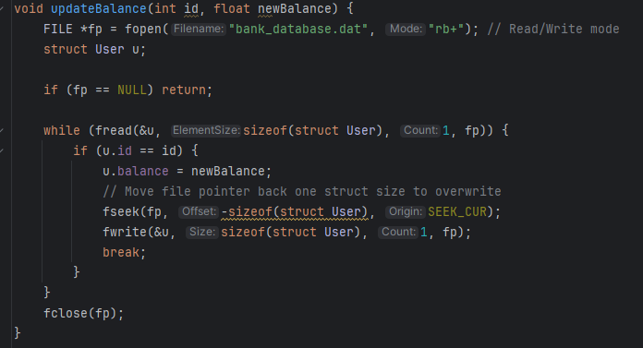
Deposit / Withdraw Function
We use the “FILE” Datatype to access the customers information from the “Bankdatabase.dat” file
The “fread()”function reads a block of memory from the file.
The “fseek()” moves the file cursor to a specific location
The “fwrite()” function writes the updated data back to the file
The “fclose()” function closes the connection to the file, ensuring the data is actually saved.

Slide 9
Transaction History via Stack (LIFO)
Why Stack?
Real-world Need: When you open a bank app, you want to see your newest transaction first.
LIFO Property: A Stack follows Last-In, First-Out (LIFO). The last transaction done is sitting on TOP.
The Steps :
PUSH (Adding a Transaction): Every deposit or withdrawal creates a new dynamic node and pushes it onto the top of the stack in $O(1)$ constant time.
POP (Viewing History): To show history, we pop nodes off the top one by one, displaying newest transactions first.
TEMP STACK (Preserving Data): Popping destroys the stack! So we park popped items in a temporary stack and push them right back so data isn't lost.
We chose a dynamic linked-list stack instead of an array so history grows flexibly without fixed limits, while enabling o(1) instant updates to the top item.

Slide 10
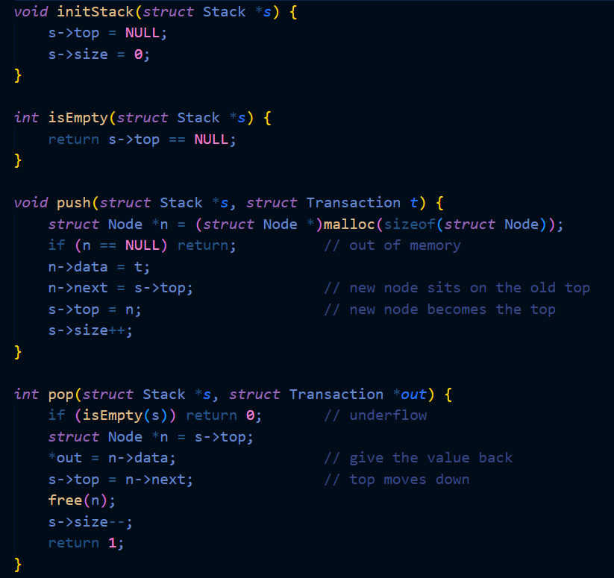
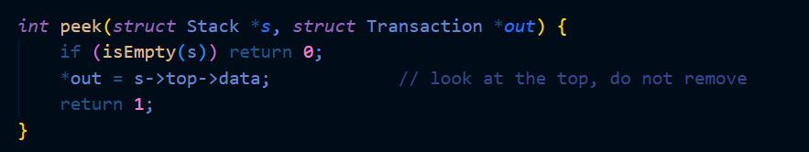
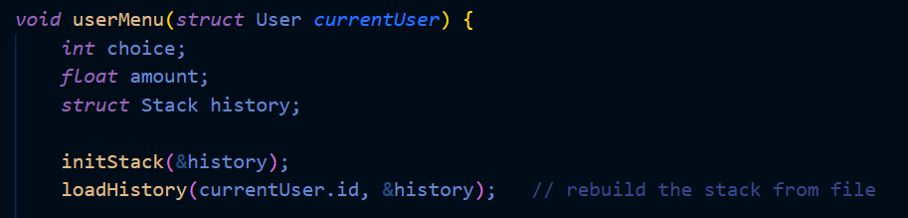
Transaction History via Stack (LIFO)

Slide 11
Key Abbreviations Used
Abbreviation | Meaning | Where it is used in the program?
%d | Integer | Used for Customer ID, Menu Choice(1,2,3)
%.2f | Floating Point Number(2 Decimals) | Used to Print Balance Only upto 2 decimal points
%[^\n]s | Scan Set(String with Spaces) | Used for Name, it tells scanf to read everything until you see a new Line
"wb" | Write Binary | Creates a new file for writing
"rb" | Read Binary | Opens an existing file Just to look at data
"ab" | Append Binary | Opens File to add data to the end
"rb+" | Read/Update Binary | Opens File to Read and Write, used in updating your Balance
fp | File Point | A Common name for the pointer that holds the file stream
%s | String (Text) | Used For Password, Pan Number, Phone Number

Slide 12
Thank You

